Slide 1
Midpoint Algorithm
Midpoint algorithm is an incremental algorithm
Assumption:
Slope < 1
Current
Pixel
x_{k+1} = x_{k}+1
y_{k+1} = Either y_{k} or y_{k}+1

Slide 2
Midpoint Algorithm - Notations
Line
( x_{k}+1, y_{k}+1)
Candidate Pixels
Midpoint
Current Pixel
( x_{k}, y_{k})
( x_{k}+1, y_{k})
Coordinates of Midpoint = ( x_{k}+1, y_{k}+(1/2) )

Slide 3
Midpoint Algorithm: Choice of the next pixel
Midpoint Below Line
Midpoint Above Line
If the midpoint is below the line, then the next pixel is (x_{k}+1, y_{k}+1).
If the midpoint is above the line, then the next pixel is (x_{k}+1, y_{k}).

Slide 4
Equation of a line revisited.
Equation of the line:
Let w = b_{x} − a_{x}, and h = b_{y} − a_{y}.
Then, h (x − a_{x}) − w (y − a_{y}) = 0.
(h, w , a_{x} , a_{y} are all integers).
In other words, every point (x, y) on the line satisfies the equation F(x, y) =0, where
F(x, y) = h (x − a_{x}) − w (y − a_{y}).
B(b_{x},b_{y})
A(a_{x},a_{y})

Slide 5
Midpoint Algorithm: Regions below and above the line.
F(x,y) < 0
(for any point above line)
F(x,y) = 0
F (x,y) > 0
(for any point below line)

Slide 6
Midpoint Algorithm Decision Criteria
F(MP) < 0
F(MP) > 0
Midpoint below line
Midpoint above line

Slide 7
Midpoint Algorithm Decision Criteria
Decision Parameter
F(MP) = F(x_{k}+1, y_{k}+ ½) = F_{k} (Notation)
If F_{k} < 0 : The midpoint is above the line. So the next pixel is (x_{k}+1, y_{k}).
If F_{k} ≥ 0 : The midpoint is below or on the line. So the next pixel is (x_{k}+1, y_{k}+1).

Slide 8
Midpoint Algorithm – Story so far.
Midpoint Below Line
Midpoint Above Line
F_{k} > 0
F_{k} < 0
y_{k+1} = y_{k}+1
y_{k+1} = y_{k}
Next pixel = (x_{k}+1, y_{k}+1)
Next pixel = (x_{k}+1, y_{k})

Slide 9
Midpoint Algorithm Update Equation
F_{k} = F(x_{k}+1, y_{k}+ ½) = h (x_{k}+1 − a_{x}) − w (y_{k}+½ − a_{y})
Update Equation
But, F_{k+1} = F_{k} + h − w (y_{k+1­­­}− y_{k}). (Refer notes)
So,
F_{k}< 0 : y_{k+1} = y_{k}. Hence, F_{k+1} = F_{k} + h .
F_{k} ≥ 0 : y_{k+1} = y_{k}+1. Hence, F_{k+1} = F_{k} + h − w.
F₀ = h − w/2.

Slide 10
Midpoint Algorithm
int h = by-ay;
int w = bx-ax;
float F=h-w/2;
int x=ax, y=ay;
for (x=ax; x<=bx; x++){
setPixel(x, y);
if(F < 0)
F+ = h;
else{
F+ = h-w;
y++;
}
}

Slide 11
Bresenham’s Algorithm
int h = by-ay;
int w = bx-ax;
int F=2*h-w;
int x=ax, y=ay;
for (x=ax; x<=bx; x++){
setPixel(x, y);
if(F < 0)
F+ = 2*h;
else{
F+ = 2*(h-w);
y++;
}
}

Slide 12
Circle Drawing Algorithms

Slide 13
Midpoint Circle Drawing Algorithm
To determine the closest pixel position to the specified circle path at each step.
For given radius r and screen center position (x_{c}, y_{c}), calculate pixel positions around a circle path centered at the coodinate origin (0,0).
Then, move each calculated position (x, y) to its proper screen position by adding x_{c} to x and y_{c} to y.
Along the circle section from x=0 to x=y in the first quadrant, the gradient varies from 0 to -1.

Slide 14
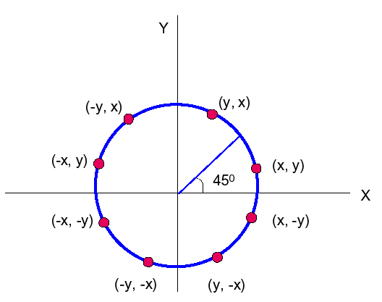
Midpoint Circle Drawing Algorithm
8 segments of octants for a circle:

Slide 15
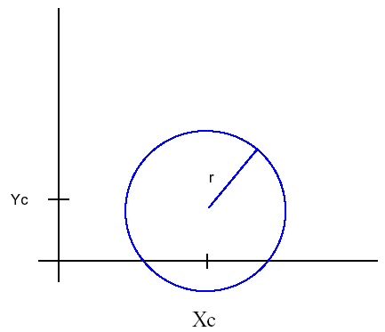
Midpoint Circle Drawing Algorithm
Circle function:
f_{circle} (x,y) = x² + y² –r²
{
> 0, (x,y) outside the circle
< 0, (x,y) inside the circle
= 0, (x,y) is on the circle boundary
f_{circle} (x,y) =

Slide 16
Midpoint Circle Drawing Algorithm
y_{k}
y_{k}
midpoint
midpoint
y_{k}-1
y_{k}-1
F_{k} < 0
F_{k} >= 0
y_{k+1} = y_{k}
y_{k+1} = y_{k} - 1
Next pixel = (x_{k}+1, y_{k})
Next pixel = (x_{k}+1, y_{k}-1)

Slide 17
Midpoint Circle Drawing Algorithm
We know x_{k+1} = x_{k}+1,
F_{k} = F(x_{k}+1, y_{k}- ½)
F_{k} = (x_{k} +1)² + (y_{k} - ½)² - r² -------- (1)
F_{k+1} = F(x_{k}+1, y_{k}- ½)
F_{k+1} = (x_{k} +2)² + (y_{k+1} - ½)² - r² -------- (2)
(2) – (1)
F_{k+1} = F_{k} + 2(x_{k}+1) + (y²_{k+1} – y²_{k}) - (y_{k+1} – y_{k}) + 1
If F_{k} < 0,
F_{k+1} = F_{k} + 2x_{k+1}+1
If F_{k} >= 0,
F_{k+1} = F_{k} + 2x_{k+1}+1 – 2y_{k+1}

Slide 18
Midpoint Circle Drawing Algorithm
For the initial point, (x₀ , y₀₎ = (0, r)
f₀ = f_{circle} (1, r-½ )
= 1 + (r-½ )² – r²
= 5 – r
4
≈ 1 – r

Slide 19
Midpoint Circle Drawing Algorithm
Example:
Given a circle radius = 10, determine the circle octant in the first quadrant from x=0 to x=y.
Solution:
f₀ = 5 – r
4
= 5 – 10
4
= -8.75
≈ –9

Slide 20
Midpoint Circle Drawing Algorithm
Initial (x₀, y₀) = (1,10)
Decision parameters are: 2x₀ = 2, 2y₀ = 20
k | F_{k} | x | y | 2x_{k+1} | 2y_{k+1}
0 | -9 | 1 | 10 | 2 | 20
1 | -9+2+1=-6 | 2 | 10 | 4 | 20
2 | -6+4+1=-1 | 3 | 10 | 6 | 20
3 | -1+6+1=6 | 4 | 9 | 8 | 18
4 | 6+8+1-18=-3 | 5 | 9 | 10 | 18
5 | -3+10+1=8 | 6 | 8 | 12 | 16
6 | 8+12+1-16=5 | 7 | 7 | 14 | 14

Slide 21
Midpoint Circle Drawing Algorithm
void circleMidpoint (int xCenter, int yCenter, int radius)
{
int x = 0;
Int y = radius;
int f = 1 – radius;
circlePlotPoints(xCenter, yCenter, x, y);
while (x < y) {
x++;
if (f < 0)
f += 2*x+1;
else {
y--;
f += 2*(x-y)+1; }
}
circlePlotPoints(xCenter, yCenter, x, y);
}

Slide 22
Midpoint Circle Drawing Algorithm
void circlePlotPoints (int xCenter, int yCenter, int x, int y)
{
setPixel (xCenter + x, yCenter + y);
setPixel (xCenter – x, yCenter + y);
setPixel (xCenter + x, yCenter – y);
setPixel (xCenter – x, yCenter – y);
setPixel (xCenter + y, yCenter + x);
setPixel (xCenter – y, yCenter + x);
setPixel (xCenter + y, yCenter – x);
setPixel (xCenter – y, yCenter – x);
}

